Slide 1

Bitcoin Price Prediction Using LSTM
SESHADRi RAO GUDLAVALLERU ENGINEERING COLLEGE
Department of Computer Science and Engineering
Under the guidance of
Mrs. D. Raga Vamsi M. Tech
By
P. Sri Tirumala -18481A05G3
M. YAswanth Reddy -18481A05D4
P. Hemanth Venkatesh -18481A05H0
M. Sarah Chaitanya -18481A05E3

Slide 2
Abstract :
Bitcoin is a highly volatile cryptocurrency with rising popularity. Cryptocurrency is digital currency governed by cryptographic protocols. It has revolutionized the way we think about money. The continuous increase in adoption and widespread usage has increased its value in real world applications by substantial amount. Various cryptocurrencies have been invented since 2009 but the first one to be launched as a cryptocurrency was Bitcoin. It is a form of electronic cash with no governing financial institution which can be used for online transactions or as exchange between any two parties. As it does not have central governing authority and is controlled by the general public, Bitcoin is considered a very volatile currency and its price is affected by socially constructed opinions. Cryptocurrency investors often think of in which cryptocurrency to invest? For this purpose cryptocurrency price prediction is essential. As the cryptocurrency price data is time series data, LSTM model can predict it’s value. As its price is affected by socially constructed opinions, considering these opinions also will fetch great results.

Slide 3
Introduction
Bitcoin:
Bitcoin was created by Satoshi Nakamoto, a pseudonymous person or team who outlined the technology in a 2008 white paper titled as “Bitcoin: A Peer-to-Peer Electronic Cash System”. A whitepaper is a document released by developers that explains the technology and purpose of the project they are working on.
A crypto whitepaper contains various forms of data like statistics, diagrams, and formulas. The goal of this data is to convince prospective investors to invest in that cryptocurrency.
Bitcoin is a digital money that allows for secure peer-to-peer transactions on the internet and is decentralized.
LSTM:
Long Short Term Memory Network is an advanced RNN, a sequential network, that allows information to persist.
At a high-level LSTM works very much like an RNN cell. It consists of three parts, i:e forget gate,input gate and output gate
Sentiment Analysis:
Sentiment analysis extracts the polarity of individual’s subjective opinions from normal language texts. It characterizes text into categories like "positive" or "negative" or "neutral”.

Slide 4
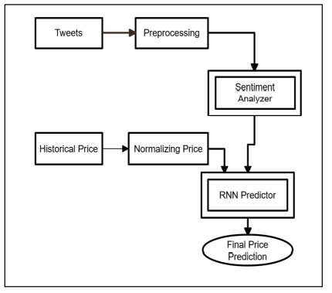
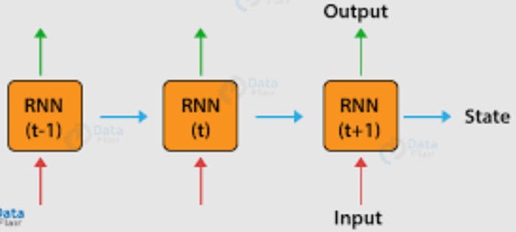
Existing System:
Recurrent Neural Network based model
A recurrent neural network (RNN) is a special type of an artificial neural network adapted to work for time series data or data that involves sequences. Ordinary feed forward neural networks are only meant for data points, which are independent of each other.
RNNs allow previous outputs to be used as inputs while having hidden states.
The formula for the current state can be written as
h_{t} = f(h_{t-1},x_{t})
h_{t}= tanh(W_{hh} h_{t-1} +W_{xh} X_{t-1} )

Slide 5
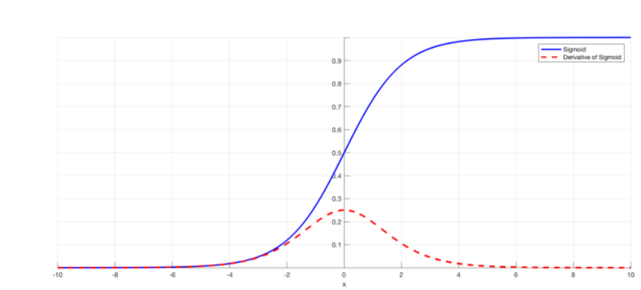
In case of a forward propagation, the inputs enter and move forward at each time step. In case of a backward propagation in this case, we are figuratively going back in time to change the weights, hence we call it the Back propagation through time(BPTT).
RNNs have the Ability to handle sequence data and inputs of varying lengths.
Drawbacks:
Vanishing Gradients:
Backpropagation finds the derivatives of the network by moving layer by layer from the final layer to the initial one. By the chain rule, the derivatives of each layer are multiplied down the network (from the final layer to the initial) to compute the derivatives of the initial layers.
When n hidden layers use an activation like the sigmoid function, n small derivatives are multiplied together. Thus, the gradient decreases exponentially as we propagate down to the initial layers.
Exploding gradients:
Exploding gradients are a problem when large error gradients accumulate and result in very large updates to neural network model weights during training.

Slide 6
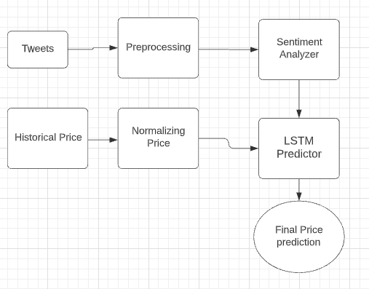
Proposed Solution:
Collect bitcoin price data in real time from coinbase, coinbasemarketPro API’s that includes prices over the course of weeks or months or years.
Collect historical tweets data from using python scraping tools from twitter with filtering words like “bitcoin”, “BTC”.
Preprocess tweets data for sentiment analysis about bitcoin.
Merge bitcoin data and preprocessed tweets data for preparing feature vector which will be given as input to LSTM model.

Slide 7
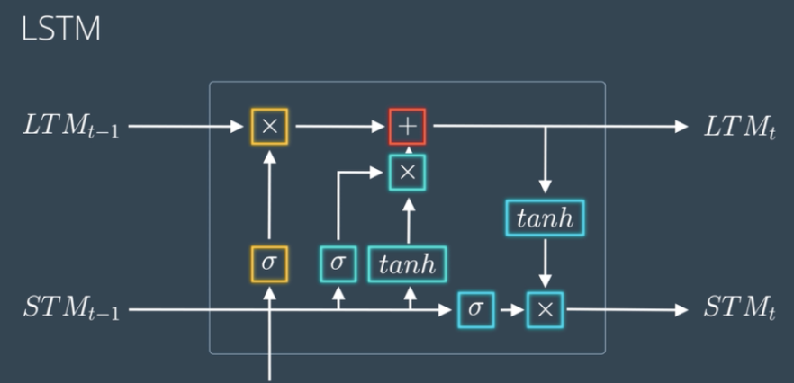
LSTM (Long Short Term Memory model)
Long Short Term Memory is a kind of recurrent neural network. It tackled the problem of long-term dependencies of RNN in which the RNN cannot predict the word stored in the long-term memory but can give more accurate predictions from the recent information. As the gap length increases RNN does not give an efficient performance.
LSTM can by default retain the information for a long period of time. It is used for processing, predicting, and classifying on the basis of time-series data
LSTM can remember long-term dependencies using cell state and gates which are forget gate,input gate and output gate

Slide 8
Procedure:
Data Collection:
Bitcoin Price data: Using CoinBasePro API, historic bitcoin price is fetched for a time range in csv format and stored
Twitter data: Using snscrape (social network scraping library) historic tweet is fetched between a time period.
To get intended data,tweets were scraped using ‘bitcoin’ keyword
Data Preprocessing:
Tweets data is preprocessed to get the polarity of tweets for each day.
Textblob in python is a library for NLP and gives polarity and subjectivity of a given text.
Feature vector Creation:
On joining Bitcoin data and Tweet polarity data ,feature vector is created which is then used as the input vector for LSTM.

Slide 9
Training with LSTM:
Unlike Neural networks LSTM considers a window of input values and one output as a single observation .
Dataset Generation for LSTM:
The feature vector is converted to test and train dataset using a value i:e loopback value. It is hyper parameter again.
For example, if the sequence was:
1, 2, 3, 4, 5, 6, 7, 8, 9, 10
Then the samples for training the model will look like:
Input | Output
1, 2, 3, 4, 5 6
2, 3, 4, 5, 6 7
3, 4, 5, 6, 7 8
The LSTM is comprised of internal gates , which allows the model to be trained successfully using backpropagation and maintains cell state to avoid vanishing gradients problem.

Slide 10
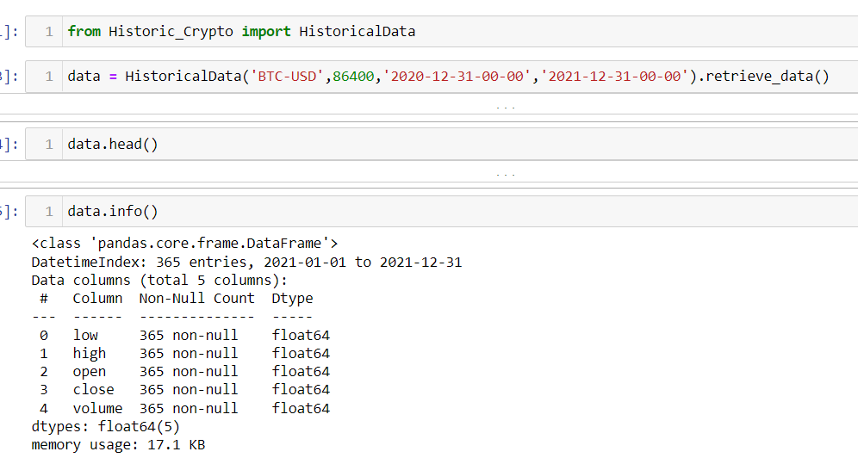
Implementation:
Data Collection: Bitcoin price data in USD value format for 1 year is fetched using python’s Historic_Crypto library which internally gets data from CoinbasePRO API
Scraping historical twitter data:
Snscrape library is social netwroks scraping llibrary used to scrape tweets without any bound or buffering limitations.

Slide 11
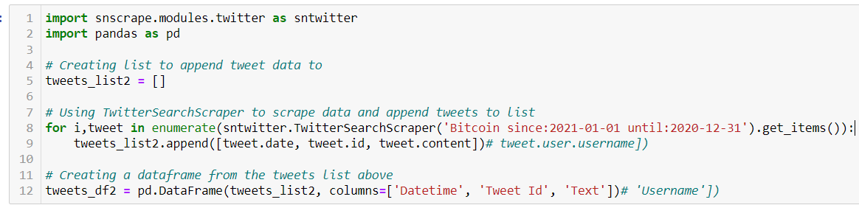
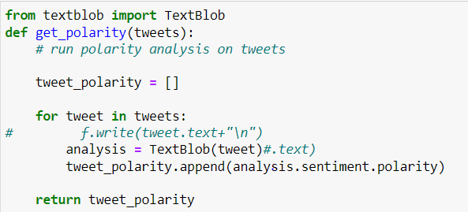
Sentiment analysis on manually collected tweets data:
As applying supervised learning model on twitter data for NLP is tedious,we are going with NLP using textblob which is a python library that gives polarity of text data.

Slide 12
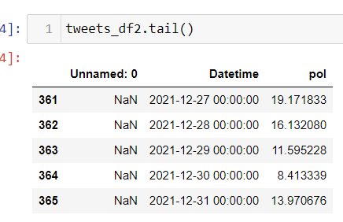
The polarity gives ranges between [-1,1],in which -1 means negative and 1 means positive.
After preprocessing and sentiment analysis on twitter data, the data looks as below
Merging Bitcoin values, Twitter data Dataframes
Now both the bitcoin and tweets data frames are joined using pandas merge command
Pandas merge command is like SQL join command and dataframes can be merged based on inner merge or outer merge aslo.

Slide 13
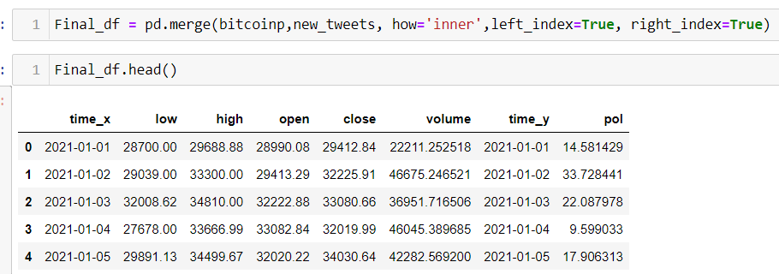
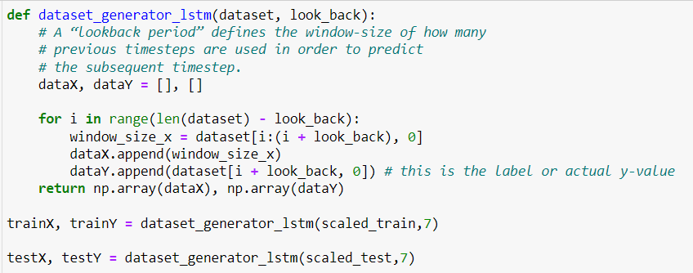
Final merged data frame looks as below
Dataset generation for LSTM:
Divide final dataset into test and train datasets,then generate datasets with loop back parameter. Here loopback is taken as 7 i:e 7 days

Slide 14
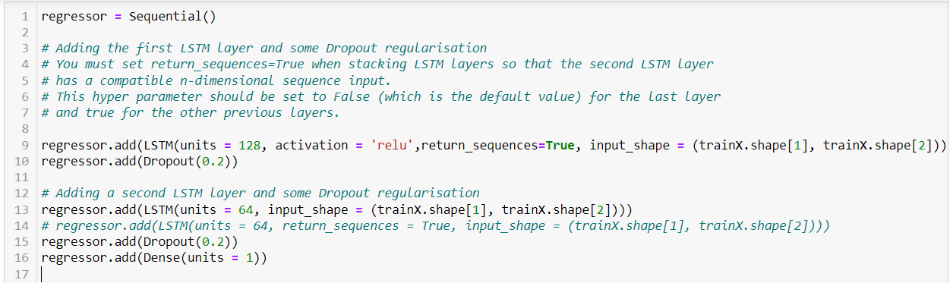
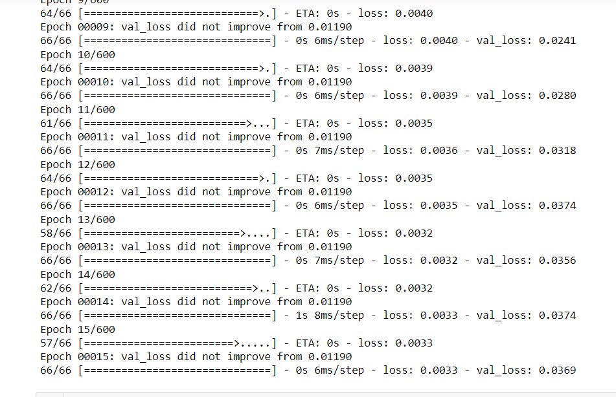
Training and Executing LSTM model:
Validation loss obtained is 0.03569

Slide 15
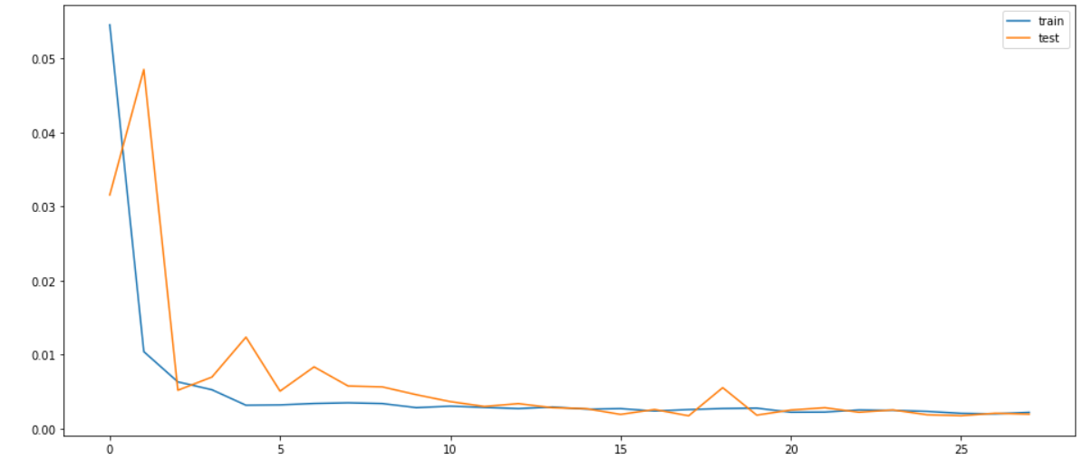
Testing loss vs validation loss plot:

Slide 16
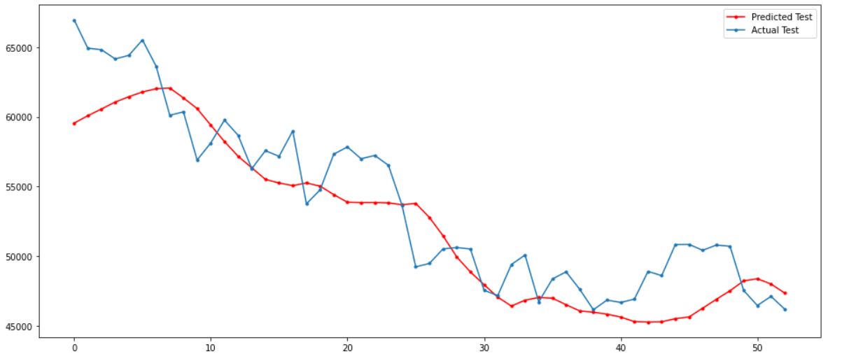
Results:
The plot against the LSTM prediction of testX and actual testY
predicted_btc_price_test_data = model_from_saved_checkpoint.predict(testX)

Slide 17
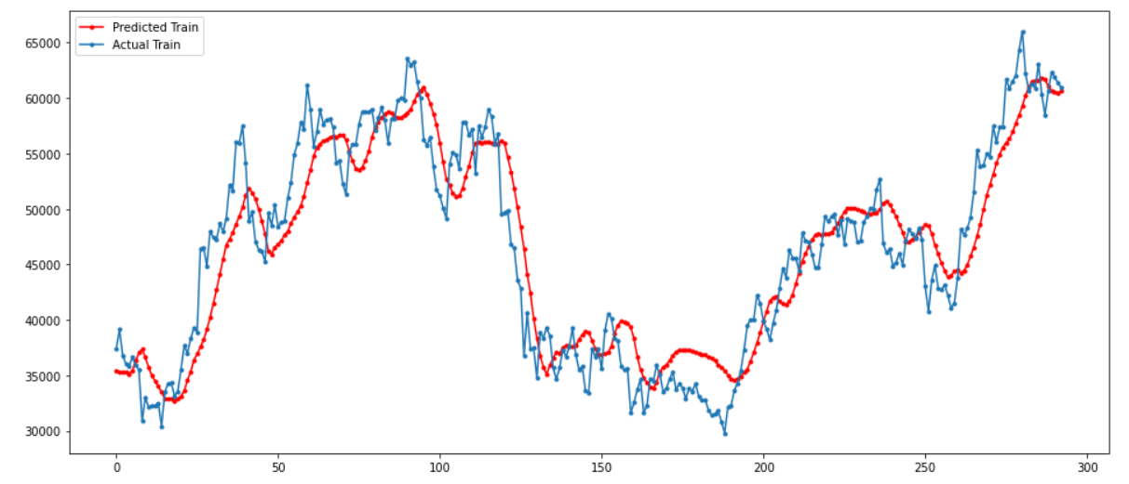
Fig: predicted train vs actual train data

Slide 18
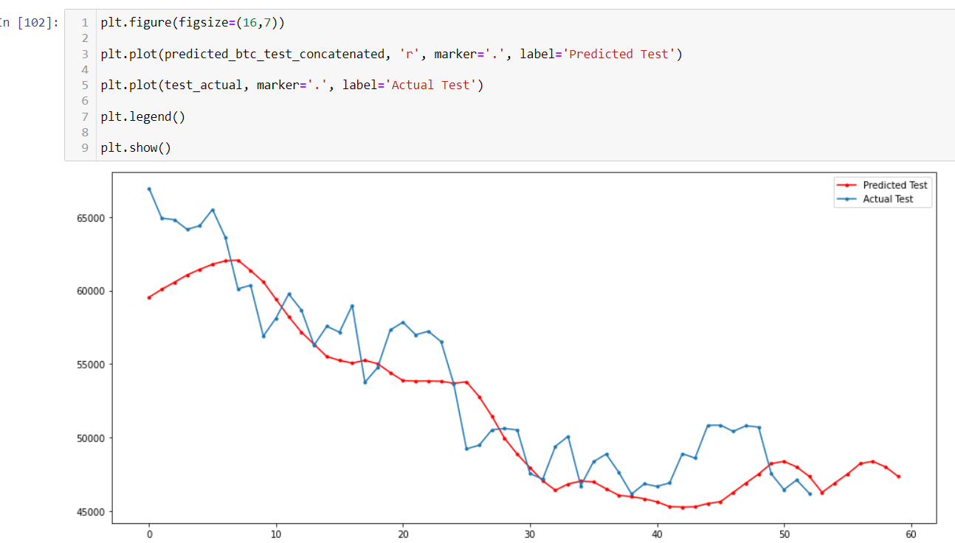
Future prediction for 7 days:

Slide 19
THANK YOU!

